Slide 1
Bachelor of Mass Communication (Hons) (Digital Media Production)

Slide 2
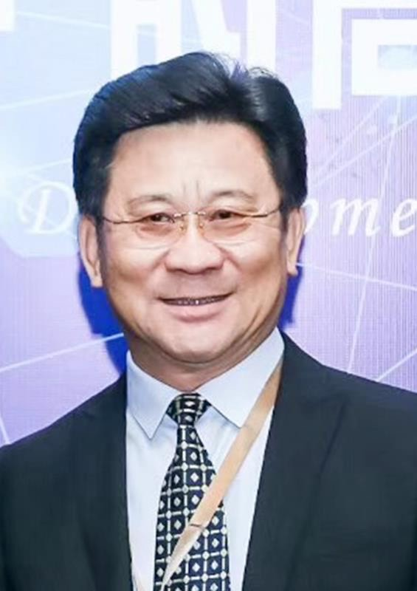
Nomination for Visiting Appointee
Professor Lu Bin
Dean of the Department of Media Management
Beijing Film Academy Modern Creative Media College (BFA-MCMC)
1st June 2020 – 31st May 2021

Slide 3
Published over a dozen books, including the very honourable “China Animation Industry Annual Report”.
Editor-in-Chief for the equally important “Blue Book of Film: Report on the Development of the Global Film Industry”, China’s leading road map for the film industry.
Heavily involved in the Chinese film industry, producing a string of films, TV shows, as well as animated cartoons. He has won international awards for his works, including the Best Cartoon Award at the prestigious Cannes TV Festival in France.
Held many important positions, such as Chairman of Kunlun International (Beijing) Film and Television Co. Ltd., and the Expert Advisor of UNESCO Creative Network City Qingdao: City of Film.

Slide 4
5-Day Visit Schedule
DAY
AM
PM
MONDAY | TUESDAY | WEDNESDAY | THURSDAY | FRIDAY
Guest lecture: Professional Media Workshop – “Producing 101: Dealing with Egos on Set” | Guest lecture: Digital Animation & Compositing – “When Film and Gaming Meet: The Next Digital Age” | Guest lecture: Digital Storytelling & Production – “ Style over Substance: Does Story Still Reign Supreme in Modern Filmmaking?” | Guest lecture: Asian Cinema – “The Art of Producing: Asian Film Industry 2020” | Guest speaker: Media and Communication Lecture Series- “Asian Cinema in Hollywood: Assimilation or Grudging Acceptance?”
Consultation: Taylor’s University Film Festival 2020 | Discussion: BMC (Hons) Digital Media Production – areas for improvement | Discussion: Proposal for new undergrad & postgrad programmes | Research: Possible collaboration projects with SOMAC lecturers | Research: Possible collaboration projects with SOMAC lecturers

